Slide 1
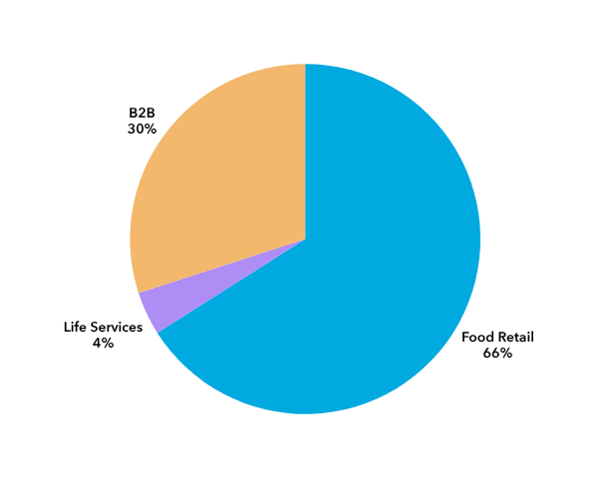
Financial Strength of the Co-op Group
Key metrics
FY25 Revenue
 | FY23 | FY24 | FY25
Number of active members, m | 5.0 | 6.2 | 7.2
Number of food stores | 2,349 | 2,348 | 2,338
Total revenue, £m | 11,262 | 11,279 | 11,025
Underlying EBITDA (Note 1), £m | 468 | 481 | 327
Operating cash, £m | 602 | 456 | 243
Liquidity headroom (Note 2), £m | 1,038 | 820 | 441
Source: Members’ Annual Report 2025 and Audited Accounts
Notes:
1 - EBITDA is operating profit excluding depreciation and amortisation
2 - Liquidity headroom is amount of cash and available funding above what is needed to meet short-term obligations
2025 was a challenging year, impacted by the cyber-attack as well as market and cost pressures. However, TCG's strong balance sheet meant that they have been able to absorb the cash impact and continue to invest.
Liquidity headroom at the end of 2025 was £441m, consisting of cash of £93m plus unused credit facilities of £348m.
TCG, and their auditors EY, considered their future main risks and uncertainties as part of their recent annual audit and confirmed that there remains sufficient liquidity headroom in their forecasts.
  Founded in 1844, TCG is a substantial £11bn business with a proven track record of strong performance. Its diversified portfolio consists of Food Retail, Wholesale/B2B and Life Services (Funeral, Legal and Insurance).
  The business employs over 53,000 staff, operates more than 2,300 own stores and delivers grocery products to over 5,600 locations.

